Slide 1

Hello.
Evolving your Power BI Architecture using Dataflows and Shared Datasets
Agenda
History lesson: Microsoft BI Enterprise Architecture
Power BI Architecture. Simple.
Dataflows
Shared Datasets
Power BI Architecture. Evolved.
Link to slides

Slide 2





Ben Watt. At your service!
ben@datalineo.com
@benrebooted
linkedin.com/in/benonline
What I do:
Managing Director at Datalineo
Microsoft MVP Data Platform
Power BI: SQL/Azure/Power Platform
Dublin PUG leader
Event Co-Ordinator:
Data Ceili
Power Platform WT

Slide 3







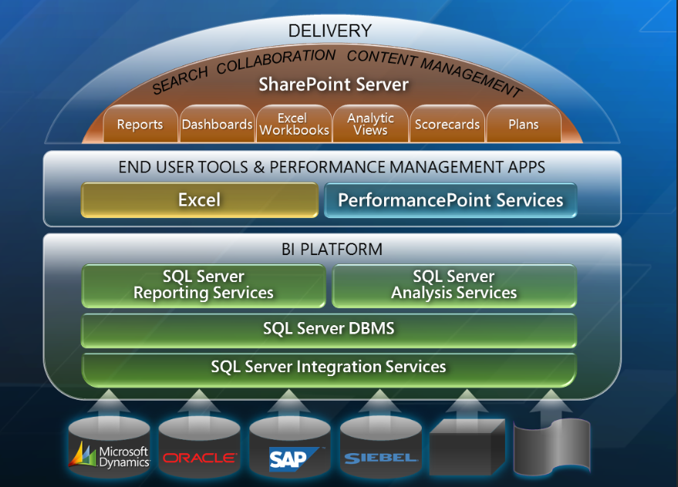
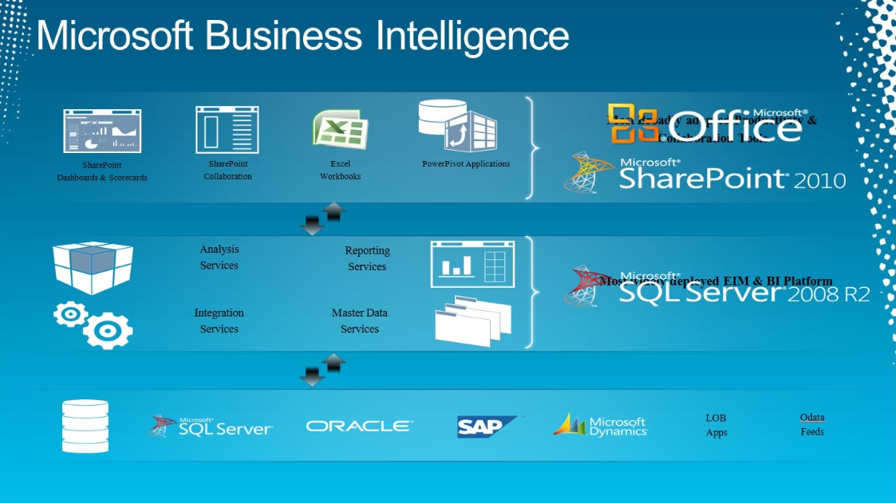
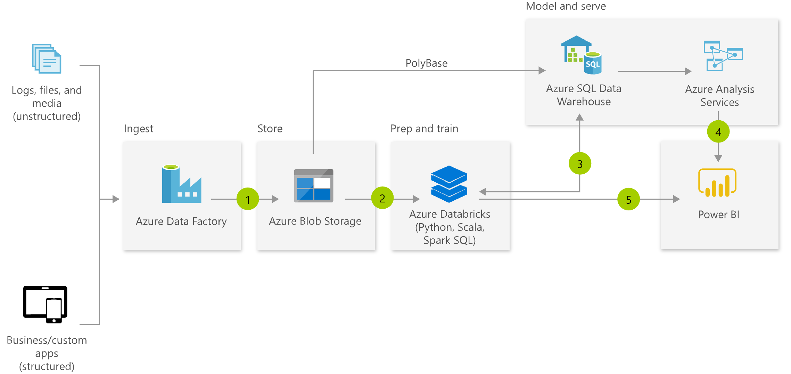
Microsoft Enterprise BI
Get
Store
Semantic
Model
Data Viz
Typical BI Solution
SQL Server/On-Prem
SSIS
DWH
SSAS
SSRS++
Tools & Technology
Azure/Cloud
ADF
SQL DB
AzureAS
Power BI
Solution Architecture through the ages

Slide 4


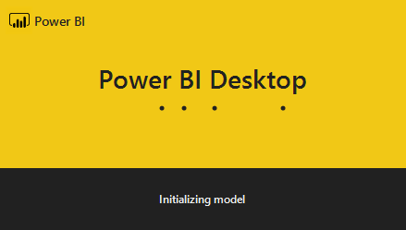

Power BI Solution. Simple.
Store
Semantic
Model
Data Viz
Get
Power BI
Power Query
PBI SSAS
PBI Viz
Power BI Service
Workspaces
One single PBIX file.
Includes:
Get, Model, Data Viz
Publish to a single workspace
Schedule refresh
Schedule
Finance
.PBIX
Sales
Works for..
Small number of report pages
Consistent audience
Minimal development

Slide 5

Let’s Scale

Slide 6
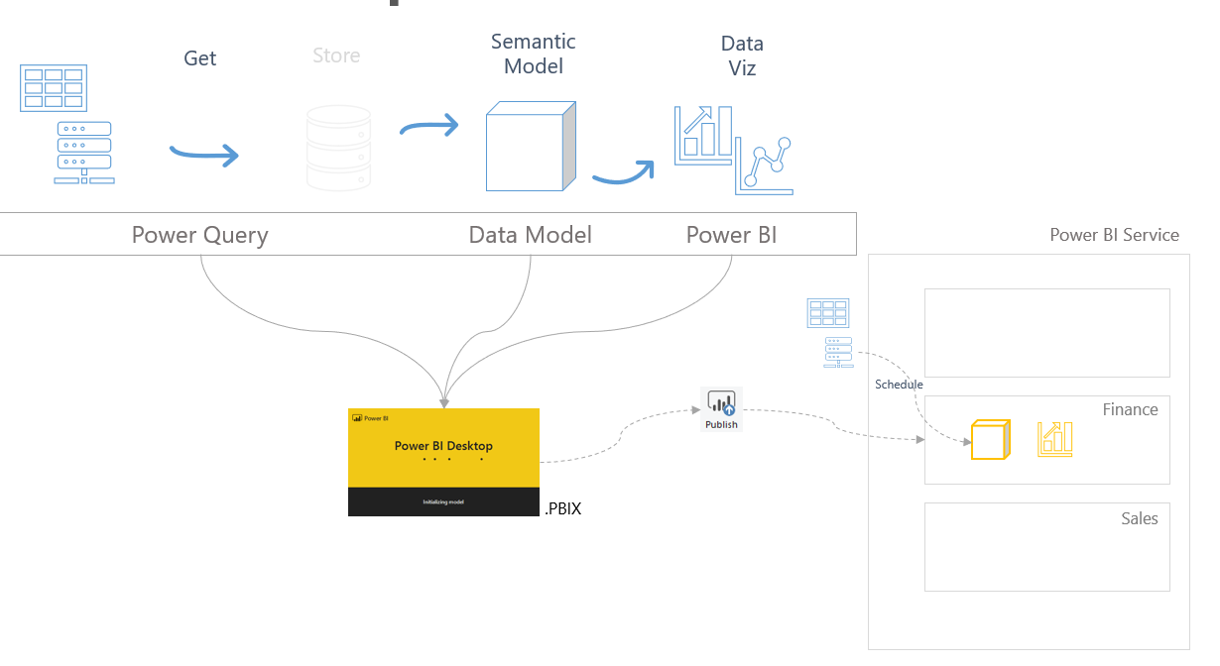

Features to help you scale
Decouples the data acquisition from the .PBIX
Makes the data available for multiple datasets
Acts like the ETL and DWH of Enterprise BI
Separates the scheduling of data acquisition & model refresh
Dataflows
Considerations
Centralises common tables/entities
E.g. a single Calendar table
Data is stored in Azure Data Lake Gen2 as CDM compliant folders.
10GB (Pro), 100TB (P1), or BYO
Develop in browser
Premium features
Incremental/Parallel refresh
Linked/Computed Entities
AI Insights

Slide 7



Features to help you scale
Dataflows
Dataflow
Schedule
Linear
Refresh
DEMO
Evolve DW workspace, intro
VanArsdel: Dimensions, Facts
Merge
Append
Dual query
Cross Dataflow query
AI Insights
Refresh History
Entities
Dataflow
Entities

Slide 8
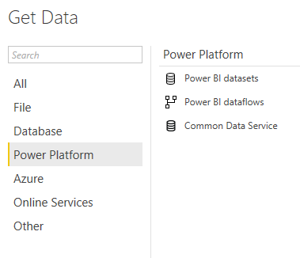

Features to help you scale
Decouples the Data Model from the Data Viz
Simplifies deployment
Removes workspace barriers
Certify and Promote Datasets
Shared Datasets
Considerations
Use Promoted or Certified Datasets
One shared dataset per PBIX: live connection
Security
Apps
Workspaces
Row Level
Build Access
Power BI Service
Data Warehouse
Schedule
Live
connection
Finance
Sales

Slide 9
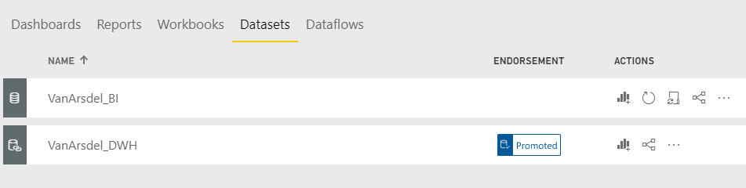
Features to help you scale
Shared Datasets
DEMO
Admin Setup: certify and promote
Connect from Power BI
Dataset
Dataflow
Workspace & Dataset security

Slide 10


Power BI Solution. Evolved.
Typical BI Solution
Store
Semantic
Model
Data Viz
Get
SQL Server/On-Prem
SSIS
RDBMS
SSAS
SSRS
Tools & Technology
Azure/Cloud
ADF
SQL DB
AzureAS
Power BI
Shared Data Model
Live
Connection Reports
Dataflows
Power BI Evolved
Power Query
CDM
PBI SSAS
PBI Viz
Dataflows

Slide 11
When should I evolve?
Don’t plan to evolve. Decide early.
Keep simple models simple.
Consider Shared Datasets or Dataflows:
Shared Datasets
If number of reports will grow or vary
If users are spread across varying groups
Dataflows
Re-usable business logic
To be kind to data sources (reduce query load)
Report
Dataset
Dataflow

Slide 12

Thank you!
ben@datalineo.com
@benrebooted
linkedin.com/in/benonline
Slides, etc:
https://github.com/datalineo/sessions/EvolvePowerBIArchitecture

